Slide 1
NEWSFEED
GROUP-47

Slide 2
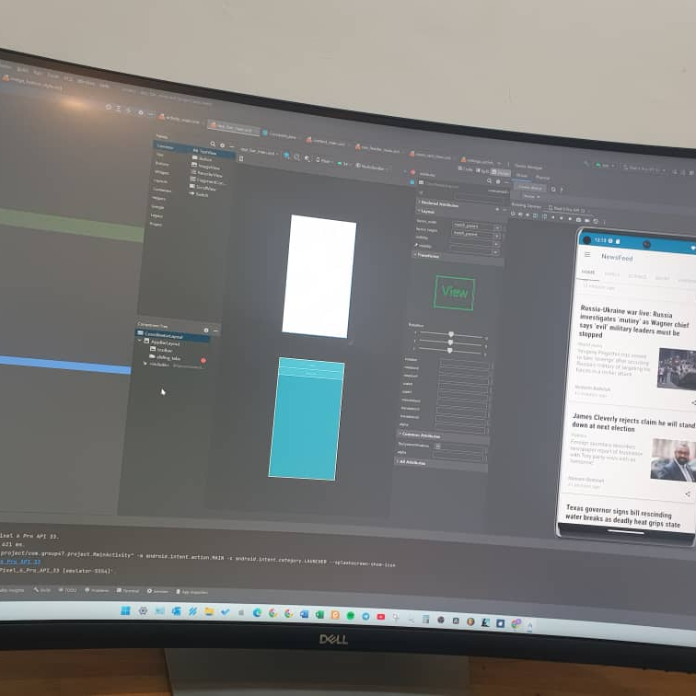
OVERVIEW
Introduction
Progress
Blueprint
Functionality
Challenges
Team
Summary

Slide 3
NEWSFEED
A WEBBASED MOBILE APPLICATION
THIS IS AN OVERVIEW OF THE APPLICATION

Slide 4

Introduction
The FeedNews application is a user-friendly and feature-rich mobile application designed to provide users with access to a wide range of news articles from various categories. With a clean and intuitive interface, the app allows users to browse and read news articles based on their interests. Whether it's business, culture, science, or any other topic, the application offers a comprehensive collection of news from different sources.

Slide 5
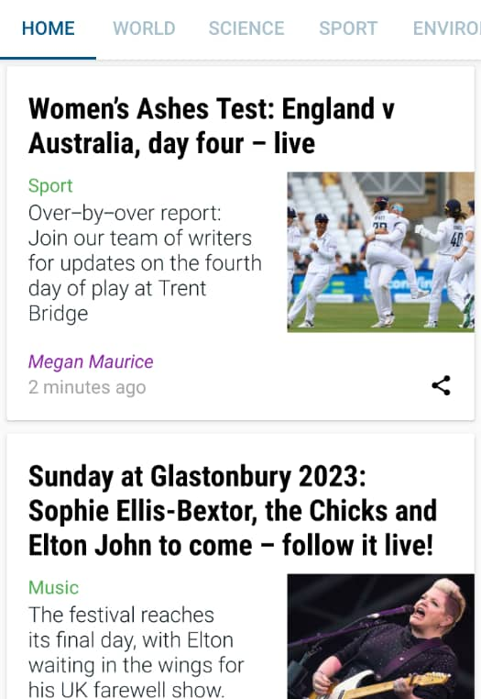
This newsfeed app fetchS news from guardian news, Through api.
This NewsFeed also take users to guardian website when users click on a news or article.

Slide 6
progress
The "SettingsActivity" class provides a dedicated interface for managing app settings.
The "res" directory contains various resource files, including layouts, drawables, strings, and themes.
XML layout files define the structure and appearance of UI screens and components.
Menu files define menus and navigation options for the application.
Resource values are defined in XML files for central management.
Styles and themes are defined to ensure consistent visual styles and theming options.
XML files in the "xml" directory handle backup, data extraction, and main settings layout.

Slide 7
progress
Android manifest files provide essential information about the application to the Android system.
Java source code files are present in the "java" directory, indicating progress in implementing the core logic of the application.
Adapter classes are responsible for binding data to UI components, such as RecyclerView or ViewPager.

Slide 8
progress
Fragment classes represent individual sections or categories of news within the application.
Utility classes provide reusable code components for enhancing functionality.
The main activity class serves as the entry point and orchestrates the overall behavior of the app.
The "News" class represents news items or related data.
Asynchronous news loading is implemented using the "NewsLoader" class.
News preferences and settings are managed by the "NewsPreferences" class.

Slide 9
blueprint
HOMEPAGE
TAB
SETTINGS. When click the three horizontal dots
TEXT SIZE

Slide 10
blueprint
ORDER DATE
ORDERBY
FROM DATE
SETTINGS

Slide 11
Functionality
1
When the application is launched, the MainActivity.java serves as the entry point, displaying the main activity layout (activity_main.xml).
2
The main activity layout (activity_main.xml) includes an app bar or toolbar (app_bar_main.xml) and a content area (content_main.xml) where the news fragments will be displayed.
3
The app bar or toolbar (app_bar_main.xml) contains menu items defined in the menu directory, such as the main menu (main.xml) and the navigation drawer menu (activity_main_drawer.xml).
4
The navigation drawer menu (activity_main_drawer.xml) allows users to select different categories of news, such as Business, Culture, Science, etc. These categories are represented by fragments like BusinessFragment.java, CultureFragment.java, ScienceFragment.java, etc.
5
When a category is selected from the navigation drawer, the corresponding fragment (e.g., BusinessFragment.java) is loaded and displayed in the content area (content_main.xml) of the main activity

Slide 12
Functionality
6
The news articles within each category are displayed using a RecyclerView, and the NewsAdapter.java class is responsible for binding the news data to the RecyclerView.
7
Users can scroll through the news articles within a category and click on an article to view its details or read the full article.
8
The app bar or toolbar (app_bar_main.xml) contains menu items defined in the menu directory, such as the main menu (main.xml) and the navigation drawer menu (activity_main_drawer.xml).
9
The Notes pane is a box that appears below each slide. Tap it to add notes.
10
If you don’t see the Notes pane or it is completely minimized, click Notes on the task bar across the bottom of the PowerPoint window.

Slide 13
Functionality
11
The NewsPreferences.java class handles the storage and retrieval of user preferences related to the news application.
12
The application includes various XML files in the res directory, such as drawable resources (icons and images), layout files (defining UI structure), and values files (defining strings, colors, etc.), to provide a visually appealing and localized user interface.
13
The utility classes in the utils directory, such as Constants.java and QueryUtils.java, provide additional functionality and helper methods to assist with tasks like networking, data retrieval, or general utility functions.
14
The XML files in the themes directory define different themes for the application, allowing users to choose between a light theme and a dark theme variant (themes.xml, themes.xml(night)).
15
The application may also include additional functionality not explicitly mentioned in the file structure, such as caching news data, bookmarking articles, or sharing articles via social media platforms.

Slide 14
chanllenges
Remote Collaboration: Working on a project remotely poses challenges in terms of effective collaboration among team members. Communication and coordination can be more difficult when not physically present in the same location.
Communication Barriers: Remote work can lead to communication barriers, such as delays in responses, misinterpretation of messages, or difficulties in conveying complex ideas or feedback effectively.
Lack of Face-to-Face Interaction: Not being able to have face-to-face interactions can hinder team bonding, personal connections, and the ability to quickly address issues or resolve conflicts.

Slide 15
chanllenges
Technical Challenges: Remote work heavily relies on technology, and technical issues such as internet connectivity problems, software compatibility, or access to necessary tools can hinder progress and productivity.

Slide 16
Team
Edward Team Leader
Programmer
Adu-Atakora UI/UX developer
Gyarko UI/UX developer
Emmanuel UI/UX developer

Slide 17
Team
Muhammed Al-Jabbar Programmer
Emmanuel UI/UX developer
Wisom Blueprint
Emmanuel Programmer

Slide 18
Team
Shadrack UI/UX developer
N/A N/A

Slide 19



Summary
The News application offers a seamless and personalized news reading experience. By organizing news articles into different categories, utilizing RecyclerViews and a ViewPager, and providing customization options, the app empowers users to stay informed and engaged with the latest news, all within a user-friendly and visually appealing environment.

Slide 20




Thank you
GROUP-47

